Slide 1
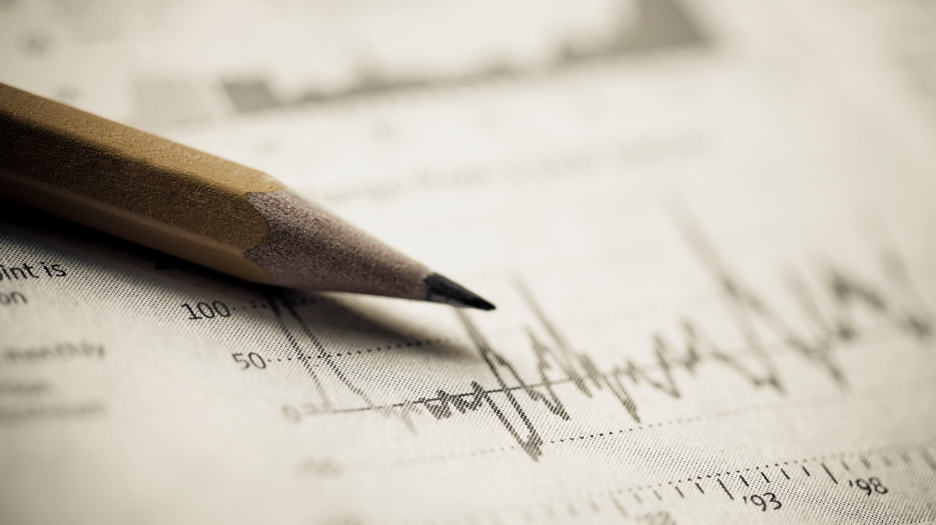
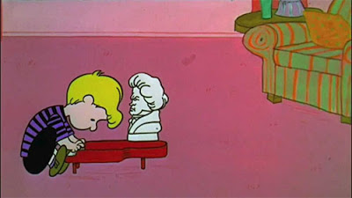
Currently practicing for a new piece.
Status Checker
Current stats

